Slide 1
The Shifting Landscape of Foodborne Illness Litigation
William D. Marler, Esq.
Marler Clark LLP PS

Slide 2
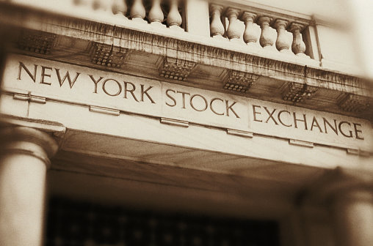
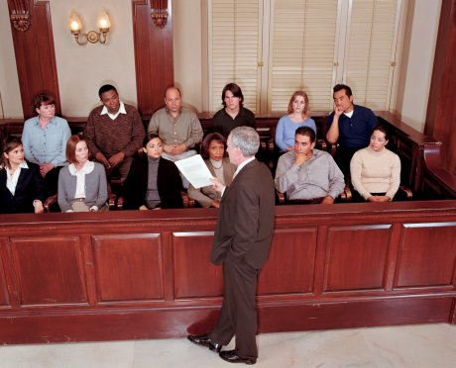
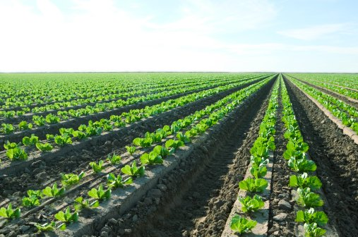
Food Production is a Risky Business
Highly Competitive Markets
Wall Street and Stockholder Pressures for Increasing Profits
Lack of Clear Reward For Marketing and Practicing Food Safety
Risk of Outbreaks and Resulting Litigation

Slide 3
It is a Global Food Economy

Slide 4
Strict Product Liability
Strict Liability
Are you a manufacturer?
Was the product unsafe?
Did product cause injury?
Punitive Damages /Felony Liability
Did you act with conscious disregard of a known safety risk?
Negligence
Are you a product seller?
Did you act “reasonably”?
Notes:
4

Slide 5
It’s called STRICT Liability for a Reason
The only defense is prevention
It does not matter if you took all reasonable precautions
If you manufacture a product that makes someone sick you are going to pay
Wishful thinking does not help
Notes:
5

Slide 6
Notes:
6

Slide 7
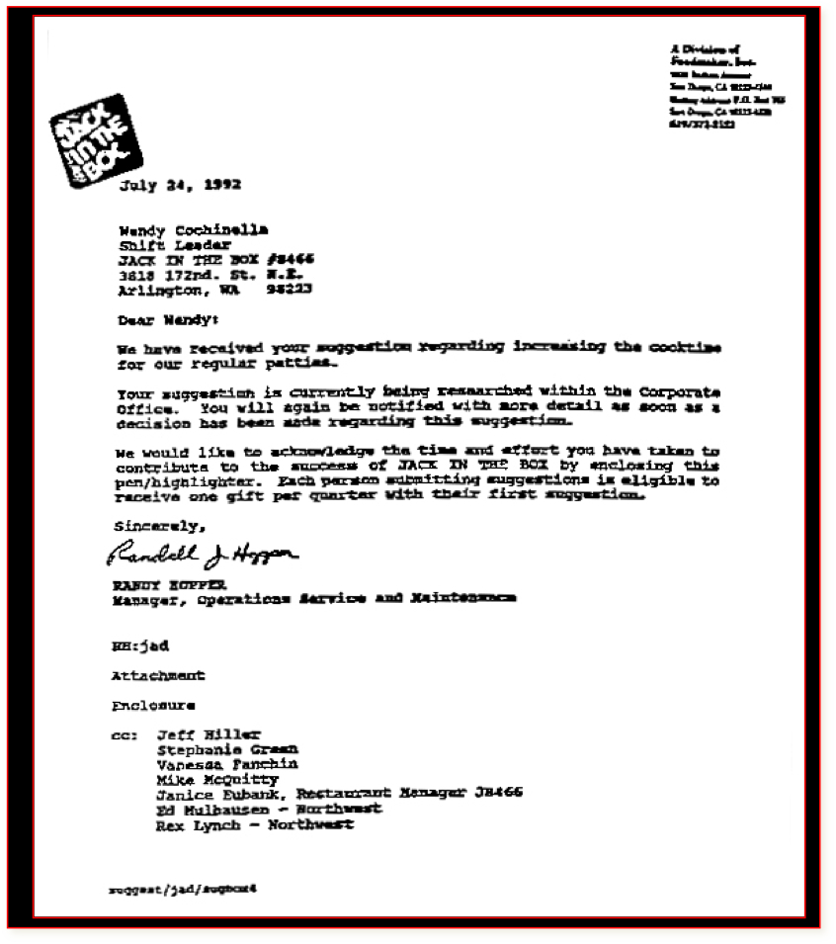
Notes:
7

Slide 8
Notes:
8

Slide 9
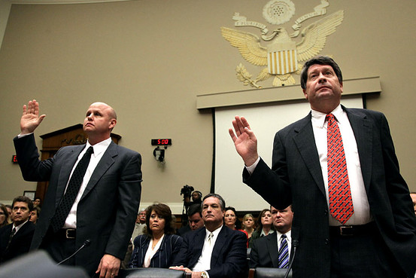
Are things are Different Today?

Slide 10
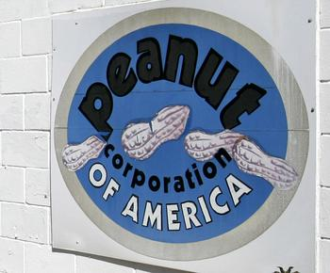
It Started with just a Little Salmonella
714 persons infected with the outbreak strain of Salmonella Typhimurium were reported from 46 states. Additionally, one ill person was reported from Canada.
Nine deaths: Idaho (1), Minnesota (3), North Carolina (1), Ohio (2), and Virginia (2).

Slide 11
Then there were Congressional Hearings
“Turn them loose,” Parnell had told his plant manager in an internal e-mail disclosed at the House hearing. The e-mail referred to products that once were deemed contaminated but were cleared in a second test last year.
Parnell ordered products identified with salmonella to be shipped and quoting his complaints that tests discovering the contaminated food were “costing us huge $$$$$.”
Parnell insisted that the outbreak did not start at his plant, calling that a misunderstanding by the media and public health officials. “No salmonella has been found anywhere else in our products, or in our plants, or in any unopened containers of our product.”
Parnell complained to a worker after they notified him that salmonella had been found in more products. “I go thru this about once a week,” he wrote in a June 2008 e-mail. “I will hold my breath ………. again.”

Slide 12
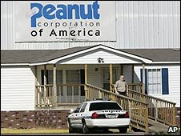
Now a 76 Count Federal Indictment
Stewart Parnell, the former owner of Peanut Corp. of America
Michael Parnell, who is Stewart Parnell’s brother and a former supervisor
Samuel Lightsey, a onetime plant operator
Mary Wilkerson, a former quality-assurance manager
Daniel Kilgore, plant manager
Allegations Include:
Mail Fraud
Wire Fraud
Introduction of Adulterated and Misbranded Food into Interstate Commerce with Intent to Defraud or Mislead
Conspiracy

Slide 13
And, It Does Not Always Require Intent
A misdemeanor conviction under the FDCA, unlike a felony conviction, does not require proof of fraudulent intent, or even of knowing or willful conduct.
Rather, a person may be convicted if he or she held a position of responsibility or authority in a firm such that the person could have prevented the violation.
Convictions under the misdemeanor provisions are punishable by not more than one year or fined not more than $250,000 or both.

Slide 14
An Auditor’s Duty to Consumers?
Recent Federal Court ruling:
While the degree of certainty of harm to Mr. Beach is not decisively in favor of imposing a duty in this instance, there is certainly moral blame that can be attached to Primus Group's conduct due to the alleged large oversights committed during the July 25, 2011 audit. Additionally, there is clearly a need to prevent future harm in situations like this, where innocent consumers eat what they think to be healthy food, which turns out to be contaminated with a potentially lethal pathogen. Further, imposing such a duty neither places an inordinately heavy burden on food safety auditors, nor causes great consequences to the community. In fact, the burden placed on food safety auditors remains unchanged-had the audit not reflected that the packing facility was in total compliance with food safety standards when it allegedly was not, Primus Group presumably would not have been named as a party in this case, if this case would even have been filed. Finally, although not briefed on the issue, it certainly stands to reason that there is insurance available for food safety auditors in conducting food safety audits, just as there is malpractice insurance for doctors or lawyers.

Slide 15
Lessons Learned
You can insure the brand’s and the company’s reputation – And, avoid me!
Arm yourself with good, current information
Since you have a choice between doing nothing or being proactive, be proactive
Make food safety part of everything you do
Treat your customers with respect
Notes:
15

